Slide 1
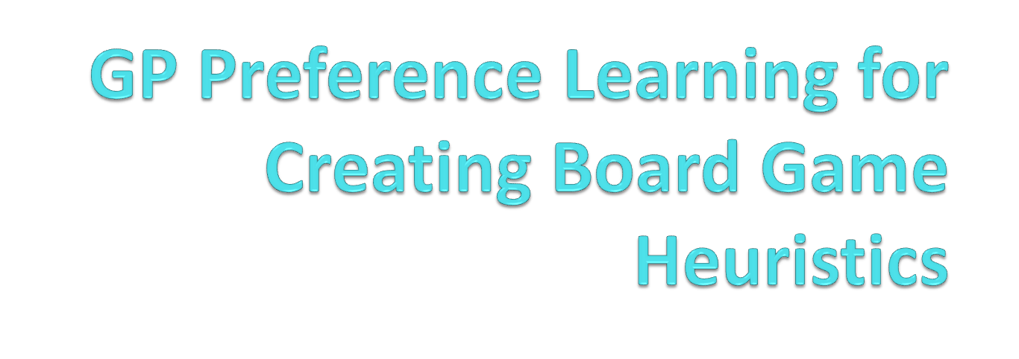
-Vignesh Rao, Y
Media Informatics

Slide 2
Motivation
Finding an optimal Heuristic for a Board Game.
But we don‘t know about the gaming rules.
We consider the game as a black box, yet we arrive at an optimal heuristic.

Slide 3
Games we use
We use certain configurations of Othello and Checkers game.
  We have a heuristic vector size.
  We approximate min-max tree of depth ‘d’.
  Number of playouts.

Slide 4
Recording Preferences
For each game, we record which heuristic has won.
  This acts as the dataset form which we learn.
  X = h1 ,h2 Y = +1
  So we find a latent function ‘ f ’ preserving the order
    f ( h1 ) > f ( h2 ) .
    This is a Gaussian Process defined by a mean and covariance function.

Slide 5
GP Classification
Now we consider a new function
  g ( h1 , h2 ) = f ( h1 ) – f ( h2 ).
  This now becomes a GP classification Problem
  For this Function G (also a Gaussian Process).
    New mean and Covariance functions are calculated.
    mu_g(h1, h2) = mu_f(h1) - mu_f(h2).
    K_g(h1, h2) = K_f(h1, h1) + K_f(h2, h2) - 2K_f(h1, h2).

Slide 6
Active Preference Learning
Iterate the following
  Simulate games with new pairs and record results.
  Infer the Valuation function.(Using GPC).
  Formulate the Expected Improvement Function(EIF).
  Optimize EIF to obtain next best query point.

Slide 7
Optimal Heuristic
We need to find a new heuristic pair which has the highest valuation.
So, we tradeoff between exploitation and exploration.
By doing this we can learn more efficiently by considering the regions of high uncertainity(exploring) and also high valuation(exploiting).

Slide 8
Current Status
Simulated games and recorded the results in the data set.
Implemented the new Mean and Covariance function in pyGPs framework.
Learnt the model by computing the posterior Distribution.
Tested the learning by predictions.

Slide 9
Accuracy of Learning
1000 training examples.
1000 test examples.
Each game played 3 times.
Accuracy of the Model is
  Othello : 83%
  Checkers : 86%
    This takes around 2 hours to Execute.

Slide 10
Upcoming Tasks
Implementing the Improvement Function to find an optimal heuristic.
Benchmarking the heuristic found at each iteration.

Slide 11
References
Chu, W., & Ghahramani, Z. (2005, August). Preference learning with Gaussian processes. In Proceedings of the 22nd international conference on Machine learning (pp. 137-144). ACM.
Houlsby, N., Huszar, F., Ghahramani, Z., & Hernández-lobato, J. M. (2012). Collaborative gaussian processes for preference learning. In Advances in Neural Information Processing Systems (pp. 2096-2104).
Eric, B., Freitas, N. D., & Ghosh, A. (2008). Active preference learning with discrete choice data. In Advances in neural information processing systems(pp. 409-416).

Slide 12
Thank You..!!

